Slide 1
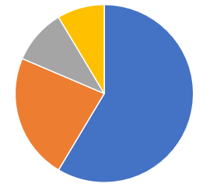
Auto Insurance Info (first endpoint is insured_education_level column from source .csv file; can filter on endpoint)
Insured Education Level
Insured Age
Insured State of Residence
Insured Gender
Associate
College
High School
JD
Masters
MD
PhD

